Slide 1
Stock management system
Project by:
1. Shivkesh yadav
2. Pramod kumar
3. Neeraj Chaudhary
4. Harishankar yadav

Slide 2
Basic Idea…
We manage stock of a company which we can help the company to work easily.
By using this technique we can avoid the problem of over stocking and out stocking.
Maintain all the records in digital form after export & import.
We can also manage the record of employee in the company.

Slide 3
Languages uses (Frontend)
HTML5
CSS
BOOTSTRAP
JAVASCRIPT
JQUARY

Slide 4
Languages Used (Backend)
DATABASE:
MYSQL
APACHE TOMCAT
PHP

Slide 5
System used
Window 10Professional(64bit)
RAM 4GB
Processor 1.5Hz

Slide 6
Software Used:
Eclipse Mars(IDE)
Apache Tomcat 7.0.75
MySQL 5.7
Toad for MySQL editor
Google Chrome Version(Official Build)
Java(TM) SE Runtime Environment

Slide 7
Beneﬁts Of The Project
No time spent on writing or ﬁnd anytime on paper.
Bill can generate instantly and digitally.
Data will not destroy at any condition and always be stay in original quality.
System work 24*7
It saves paper and increase the speed

Slide 8
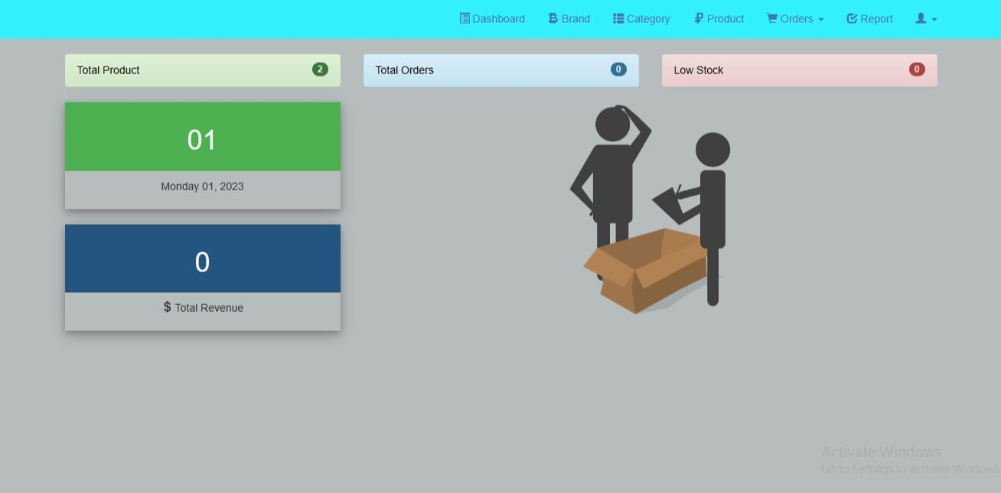
Design

Slide 9
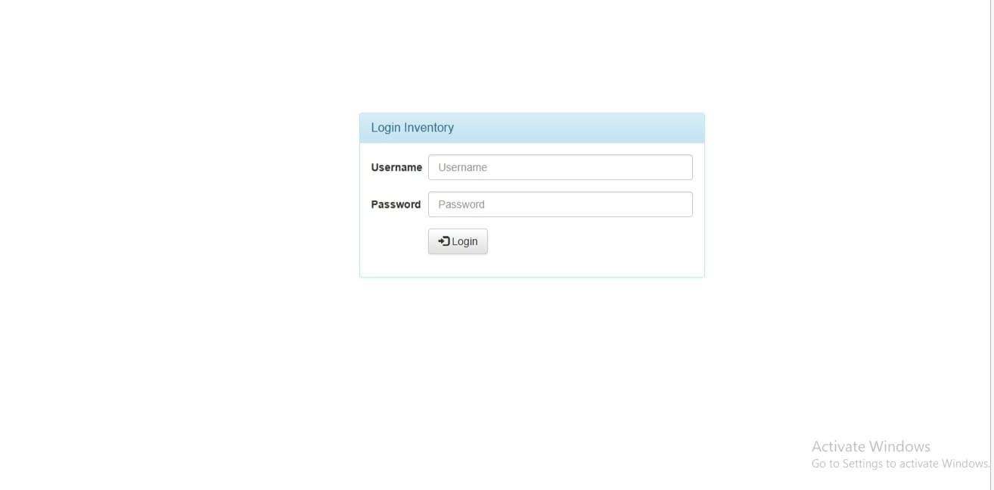
Login page

Slide 10
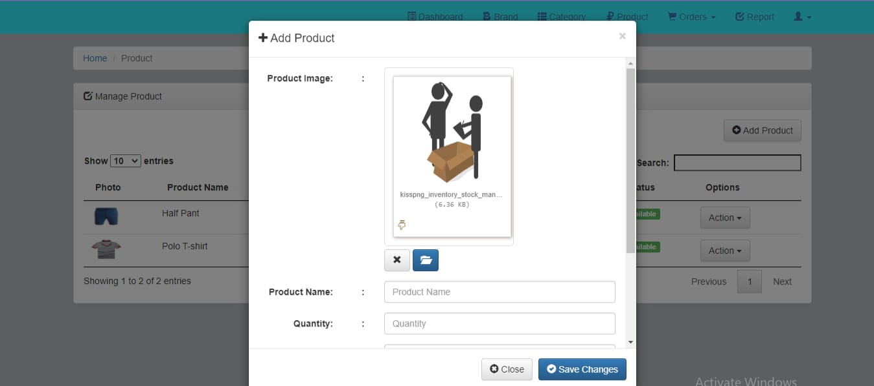
Add product

Slide 11
OBJECTIVES
To avoid both overstocking and under-stocking of inventory
To eliminate duplication in ordering stocks
To ensure a continuous supply of materials and stock so that production should not suffer at the time of customers demand.
To minimize loss through deterioration, pilferage, wastages, and damages.

Slide 12
Conclusion
The web application provide the facility of manage the stock of stores, mall, and ﬁrms digitally.
It saves a lot of time and provides many different facilities in just one web application.
Only authorized and employee have its valid own username and password.

Slide 13
THANK YOU

